Slide 1
Threading…
The last part of Unit 1.
Shriram K Vasudevan

Slide 2
Agenda . . .
Overview
Multithreading Models
Thread Libraries
Threading Issues
Operating System Examples
Windows XP Threads (Case Study)
Linux Threads (Case Study)

Slide 3
How is thread different from process?
Just as a process is identified through a process ID, a thread is identified by a thread ID. But interestingly, the similarity between the two ends here.
A process ID is unique across the system where as a thread ID is unique only in context of a single process.
A process ID is an integer value but the thread ID is not necessarily an integer value. It could well be a structure
A process ID can be printed very easily while a thread ID is not easy to print.

Slide 4
Some more differences..
Processes do not share their address space while threads executing under same process share the address space.
Context switching between threads is fast as compared to context switching between processes
The interaction between two processes is achieved only through the standard inter process communication while threads executing under the same process can communicate easily as they share most of the resources like memory, text segment etc.

Slide 5
What is a thread?
A thread is a basic unit of CPU utilization;
it comprises a thread ID, a program counter, a register set, and a stack.
It shares with other threads belonging to the same process its code section, data section, and other operating-system resources, such as open files and signals.
A traditional (or heavy weight) process has a single thread of control. If a process has multiple threads of control, it can perform more than one task at a time.

Slide 6
Note these points . . .
A process can have multiple threads of execution which are executed asynchronously.
This asynchronous execution brings in the capability of each thread handling a particular work or service independently.
Hence multiple threads running in a process handle their services which overall constitutes the complete capability of the process.

Slide 7
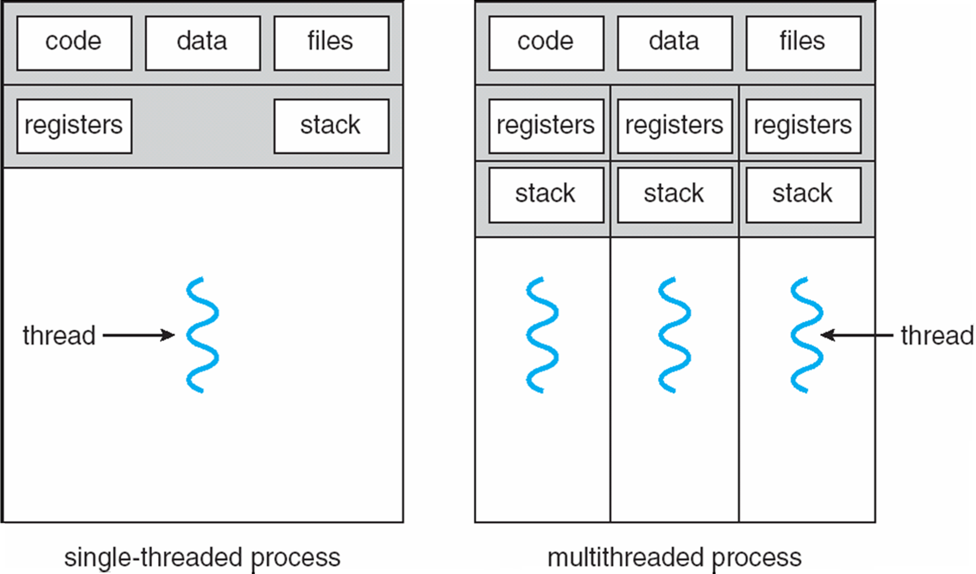
It looks like…

Slide 8
Why threading??? Who motivated?
Many software packages that run on modern desktop PCs are multithreaded. i.e. applications.
A Web browser might have one thread display images or text while another thread retrieves data from the network.
A word processor may have a thread for displaying graphics, another thread for responding to keystrokes from the user, and a third thread for performing spelling and grammar checking in the background. (It can really really go on… there is no limitation for number of threads to be used for an app)

Slide 9
Contd.,
For example, a Web server accepts client requests for Web pages, images, sound, and so forth.
A busy Web server may have several (perhaps thousands of) clients concurrently accessing it. If the Web server ran as a traditional single-threaded process, it would be able to service only one client at a time, and a client might have to wait a very long time for its request to be serviced. Let’s break this Jinx through threads!

Slide 10
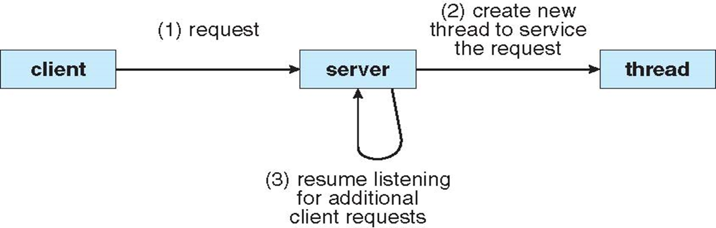
Contd.,
most operating system kernels are now multithreaded

Slide 11
Benefits
Responsiveness: Multithreading an interactive application may allow a program to continue running even if part of it is blocked or is performing a lengthy operation, thereby increasing responsiveness to the user.
For instance if a multithreaded Web browser could allow user interaction in one thread while an image was being loaded in another thread

Slide 12
Contd.,
Resource sharing: Processes may only share resources through techniques such as shared memory or message passing. Such techniques must be explicitly arranged by the programmer. Here is not so!
However, threads share the memory and the resources of the process to which they belong by default.

Slide 13
Contd.,
Economy: Allocating memory and resources for process creation is costly.
Because threads share the resources of the process to which they belong, it is more economical to create and context-switch threads.

Slide 14
Contd.,
Scalability. The benefits of multithreading can be greatly increased in a multiprocessor architecture, where threads may be running in parallel on different processors.
A single-threaded process can only run on one processor, regardless how many are available. Multithreading on a multiCPU machine increases parallelism.

Slide 15
Multi Threading Models
Note: User threads are supported above the kernel and are managed without kernel support, whereas kernel threads are supported and managed directly by the operating system (All OS Support Kernel Threads, So they run with OS!)
What is user mode?
What is kernel mode of operation?

Slide 16
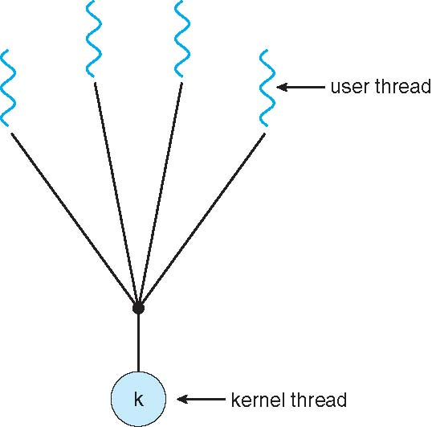
Contd.,
Many to One!
Maps many user-level threads to one kernel thread.
Thread management is done by the thread library in user space, so it is efficient;
But the entire process will block if a thread makes a blocking system call.
Also, because only one thread can access the kernel at a time, multiple threads are unable to run in parallel on multiprocessors

Slide 17
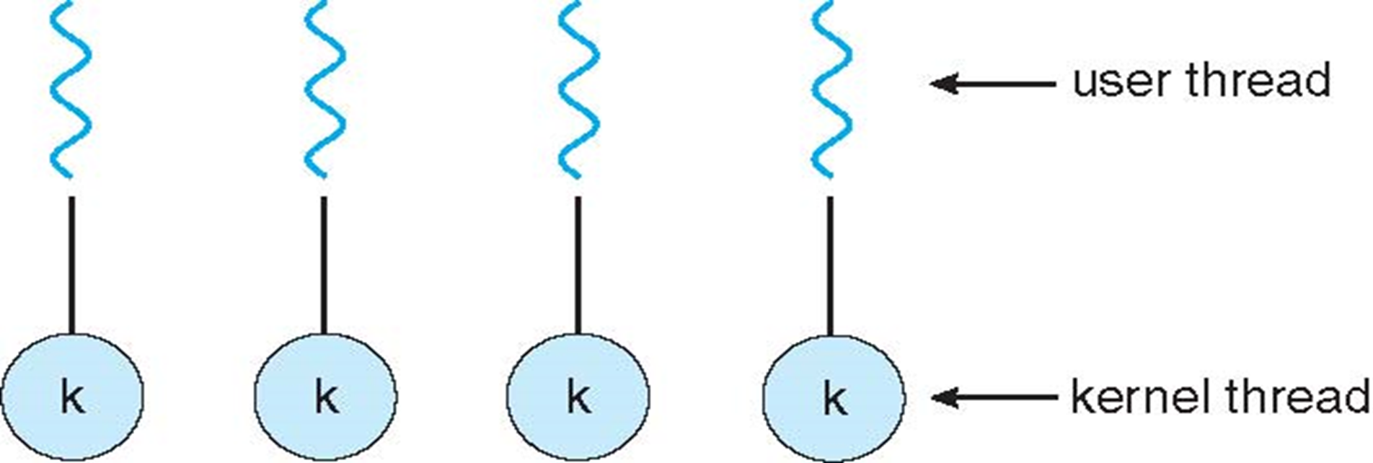
Contd.,
One-to-One Model:
It provides more concurrency than the many-to-one model by allowing another thread to run when a thread makes a blocking system call;
it also allows multiple threads to run in parallel on multiprocessors.
The only drawback to this model is that creating a user thread requires creating the corresponding kernel thread.
So??, Overhead. So restrictions are there in Number of kernel threads which can be created.

Slide 18
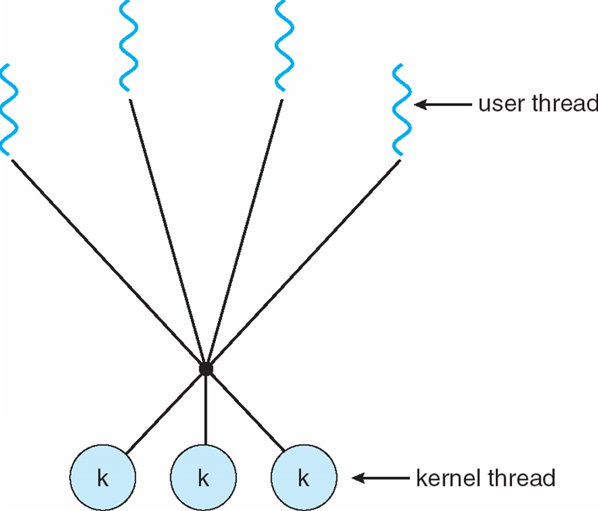
Contd.,
Many-to-Many Model:
Multiplexes many user-level threads to a smaller or equal number of kernel threads.
The number of kernel threads may be specific to either a particular application or a particular machine.
Not any shortcomings..
So Conclusion is Many to One! Has no concurrency as only one thread can access kernel at a time. One-to-One Model, developer has to be cautious about the overhead!

Slide 19
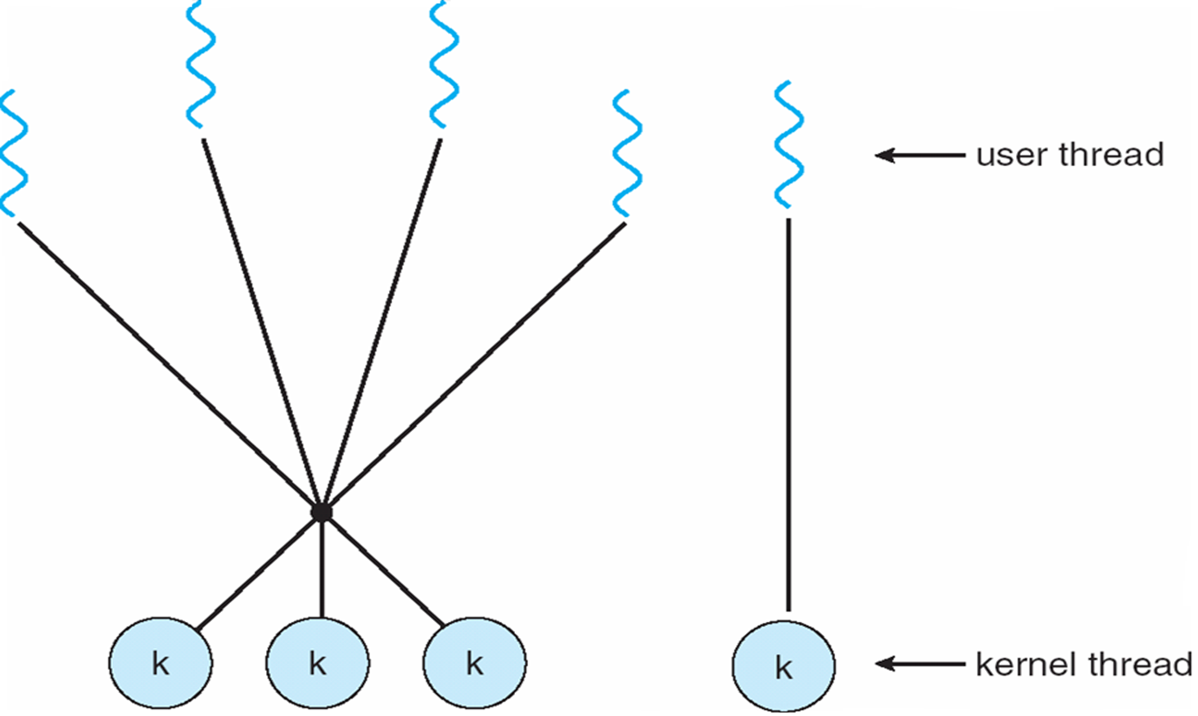
Contd.,
One popular variation on the many-to-many model still multiplexes many user-level threads to a smaller or equal number of kernel threads but also allows a user-level thread to be bound to a kernel thread.

Slide 20
Thread Libraries – An Analysis – Nandu to help.
http://crunchify.com/java-simple-thread-example/
http://www.cs.princeton.edu/courses/archive/spr96/cs333/java/tutorial/java/threads/simple.html
http://www.tutorialspoint.com/java/java_multithreading.htm
https://www.youtube.com/channel/UCQKVNTaHT-CE8yLnn4HRaqg/videos
Page 163 of book.

Slide 21
Threading issues
Fork () system call has to be considered here when we talk on threading..
If one thread in a program calls fork(), does the new process duplicate all threads, or is the new process single-threaded?
Options are available in two different flavors:
One that duplicates all threads.
Another that duplicates only the thread that invoked the fork() system call.

Slide 22
Contd.,
If a thread invokes the exec() system call, the program specified in the parameter to exec () will replace the entire process-including all threads.
Which of the two versions of fork() to use depends on the application.
If exec() is called immediately after forking, then duplicating all threads is unnecessary, as the program specified in the parameters to exec() will replace the process.
In this instance, duplicating only the calling thread is appropriate. If, however, the separate process does not call exec () after forking, the separate process should duplicate all threads.

Slide 23
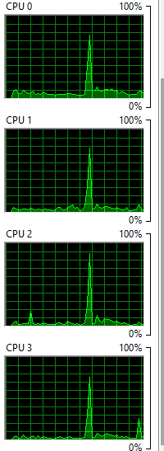
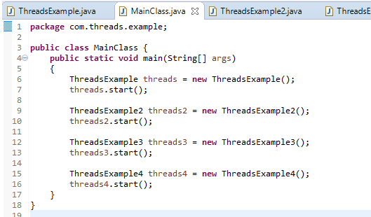
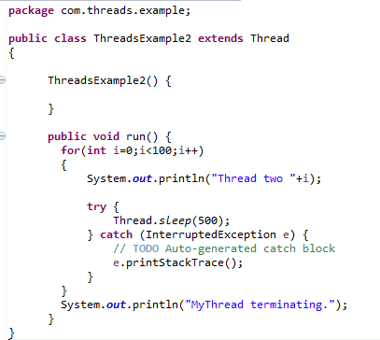
Thread Example.
A Simple example in Java would help you Guys.
4 of these similar threads to be used

Slide 24
Scheduling and Related Information
In a single-processor system, only one process can run at a time; any others must wait until the CPU is free and can be rescheduled.
Motivation:
Increased CPU Utilization.
At least One process to be handled all times.
If CPU is not doing anything, it is in idle state and All this waiting time is wasted;
No useful work is accomplished.
With multiprogramming, we try to use this time productively.

Slide 25
Contd.,
When one process has to wait, the operating system takes the CPU away from that process and gives the CPU to another process.
This pattern continues.
Every time one process has to wait, another process can take over use of the CPU.
Almost all computer resources are scheduled before use.

Slide 26
Terminologies
Scheduling Criteria
Max CPU utilization
Max throughput
Min turnaround time
Min waiting time
Min response time
CPU utilization – keep the CPU as busy as possible
Throughput – # of processes that complete their execution per time unit
Turnaround time – amount of time to execute a particular process
Waiting time – amount of time a process has been waiting in the ready queue
Response time – amount of time it takes from when a request was submitted until the first response is produced, not output (for time-sharing environment)

Slide 27
Scheduling Types
If a task is forcibly removed from running state to waiting state or ready state, else if the CPU time is pulled out from the running task and given to some other task, then that task is said to be in preemption
There are two types of scheduling.
1. Preemptive
2. Non–preemptive.
Non–preemption is just the opposite, the running task is never disturbed, instead, it is allowed to execute till it finishes.
Note:
Starvation is the key concept in choosing the scheduling method. No task should starve to get the CPU. Prolonged starvation leads to the giving up of tasks.

Slide 28
Contd.,
Preemptive scheduling methods:
1. Shortest Job First (SJF)
2. Priority scheduling
3. Round robin
Non–preemptive scheduling methods:
1. First Come First Serve (FCFS)
2. No priority/Fairness scheduling.

Slide 29
Disclaimer…
You need to code for all the stuff which are to be discussed.
Platform C or CPP… I really do not worry much about ☺

Slide 30
Shortest Job First (SJF)
The task which arrives early is let to run irrespective of its execution time.
Once some other task arrives in the ready queue, its execution time is compared with the one which is being executed.
If the new task’s execution time is lesser than the running task’s, the running task is preempted and moved to the ready queue, also the one with lesser execution time is promoted and dispatched to the running state from the ready state.
An example is always good!! ☺

Slide 31
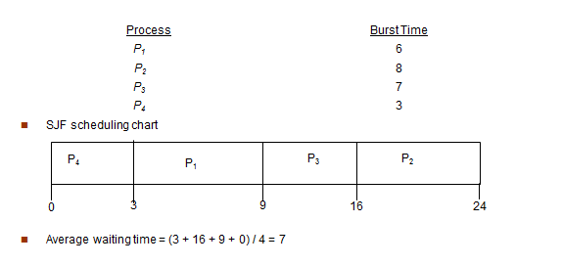
Shortest Job First (SJF)
The waiting time is 3 milliseconds for process P1, 16 milliseconds for process P2, 9 milliseconds for process P3, and 0 milliseconds for process P4 . Thus, the average waiting time is (3 + 16 + 9 + 0) I 4 = 7 milliseconds
YOU CAN WRITE A CODE FOR THIS .. THIS IS A LAB EXERCISE FOR YOU. I have attached a sample though..

Slide 32
Priority Scheduling
A priority is associated with each process, and the CPU is allocated to the process
with the highest priority. Equal-priority processes are scheduled in FCFS order.
In the SJF, priority was based on the tasks’ execution time.
Here, despite the execution time, each task is explicitly given a priority by the processor
Based on the priority, preemption happens. When a higher priority task is waiting at the ready queue and a lower priority task is running, the higher priority task pre-empts, or takes over the lower priority task.

Slide 33
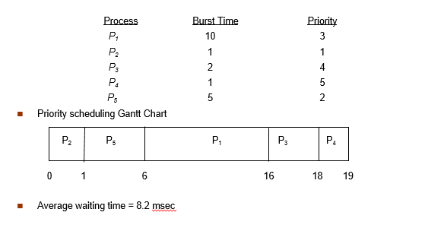
Contd.,
Priority is just a number !! And it is an integer!

Slide 34
Round Robin/Time slicing method of scheduling
It is also a preemptive scheduling method.
Tasks are chosen for execution in a round robin fashion.
The ready tasks are executed one by one for a fixed amount of time called a time slice. When that time slice expires, the task is moved to the tail end of the ready queue and the task in the front end of the queue is run next.
This process continues till all the tasks are executed.

Slide 35
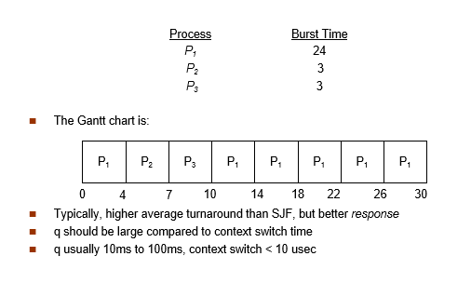
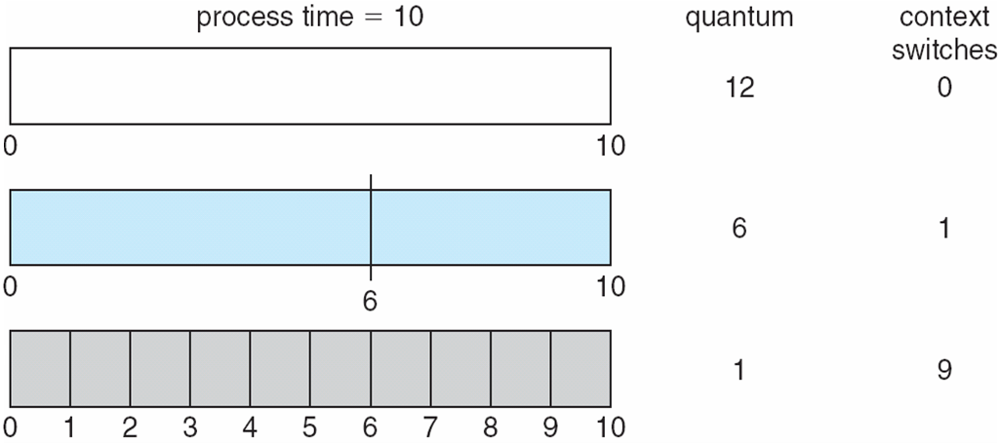
Contd.,
Each process gets a small unit of CPU time (time quantum q), usually 10-100 milliseconds. After this time has elapsed, the process is preempted and added to the end of the ready queue.
If there are n processes in the ready queue and the time quantum is q, then each process gets 1/n of the CPU time in chunks of at most q time units at once.
Timer interrupts every quantum to schedule next process

Slide 36
Contd.,
Most round-robin schedulers use a fixed size quantum.
Why always small quantum of time preferred?
An argument against a small time quantum: Efficiency. A small time quantum requires the timer to generate interrupts with short intervals. Each interrupt causes a context switch, so overhead increases with a larger number of interrupts.
An argument for a small time quantum: Response time. A large time quantum will reduce the overhead of context switching since interrupts will be generated with relatively long intervals, hence there will be fewer interrupts. However, a short job will have to wait longer time on the ready queue before it can get to execute on the processor. With a short time quantum, such a short job will finish quicker and produces the result to the end user faster than with a longer time quantum.

Slide 37
Non-preemptive Scheduling First Come First Serve Scheduling
Relatively simple concept to implement as well as to understand.
The idea is to let the tasks execute as they arrive. Execution of the tasks will be in the same order as they arrive.
Though it is simple, it has got some serious drawbacks including which, the overall waiting time of tasks would be higher than when they are scheduled in SJF, priority scheduling methodologies.
The following table has an example which would explain this drawback.

Slide 38
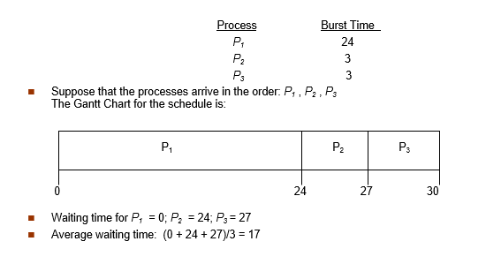
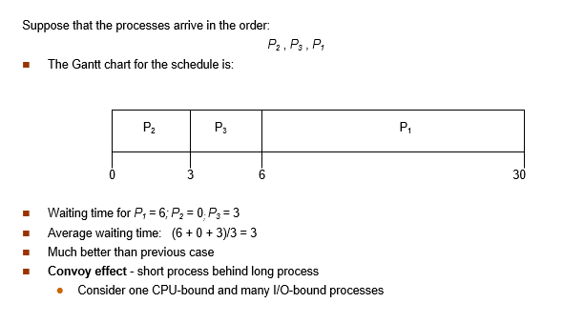
Contd.,

Slide 39
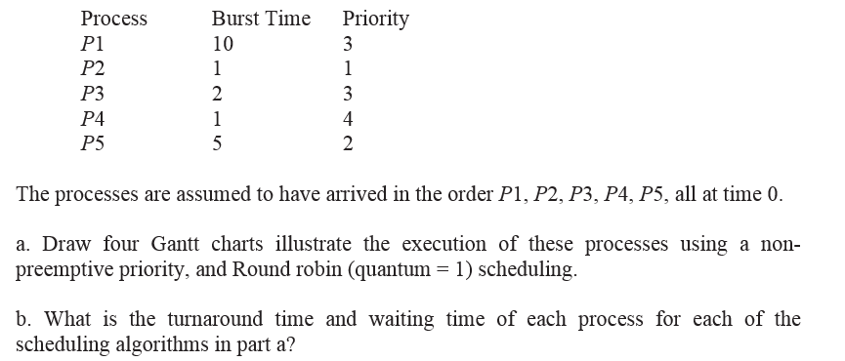
One more example..

Slide 40
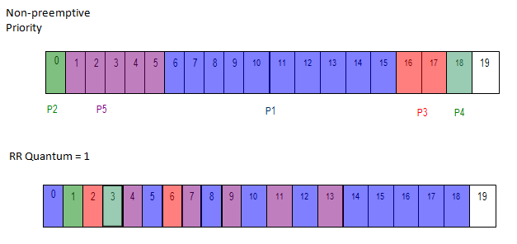
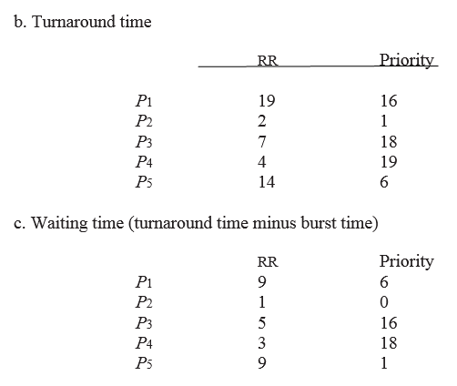
Solution..

Slide 41
Contd.,
No Priority/Fairness scheduling:
All the tasks are considered same and the CPU time is fairly distributed among the available tasks.
None is Superior / Inferior.
For instance, if there are 5 tasks available, CPU time would be divided by 5 and distributed to the tasks.
The tasks can make use of the time slice given to them. It seems to be similar to the round robin scheduling, but actually both are different.
In Round robin, time slice would be a very little amount of time in which most of the tasks would not be able to finish their execution, but in fairness scheduling most of the tasks are able to finish within the CPU time share.

Slide 42
Multilevel Queue Scheduling
Used for situations in which processes are easily classified into different groups.
Difference made between foreground (interactive) processes and background (batch) processes.
Have different response-time requirements and so may have different scheduling needs.
In addition, foreground processes may have priority (externally defined) over background processes.

Slide 43
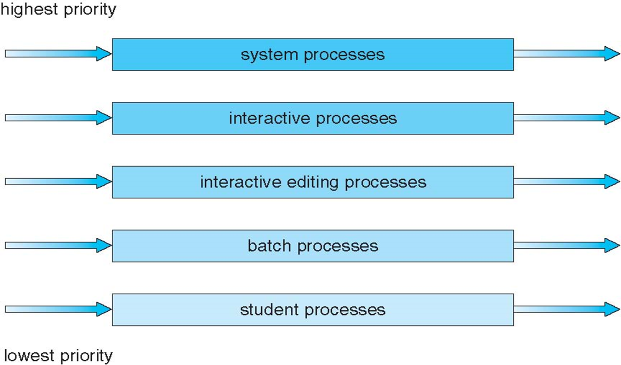
Contd.,
A multilevel queue scheduling algorithm partitions the ready queue into several separate queues.
The processes are permanently assigned to one queue, generally based on some property of the process, such as memory size, process priority, or process type.

Slide 44
Contd.,
Each queue has its own scheduling algorithm.
For example, separate queues might be used for foreground and background processes.
The foreground queue might be scheduled by an RR algorithm, while the background queue is scheduled by an FCFS algorithm.
The foreground queue may have absolute priority over the background queue.

Slide 45
Bye… Unit – I
Shriram K Vasudevan

